Slide 2
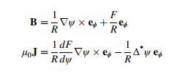

Grad-shafranov equation
$$μ_{0}R^{2}\frac{dp}{dψ}+F\frac{dF}{dψ}+Δ^{∗}ψ=0$$
With
$$Δ^{∗}ψ=R^{2}∇∙\left(\frac{∇ψ}{R^{2}}\right)=R^{2}∂_{R}\left(\frac{1}{R^{2}}∂_{R}ψ\right)+∂_{φ}^{2}ψ+∂_{z}^{2}ψ$$

Slide 3
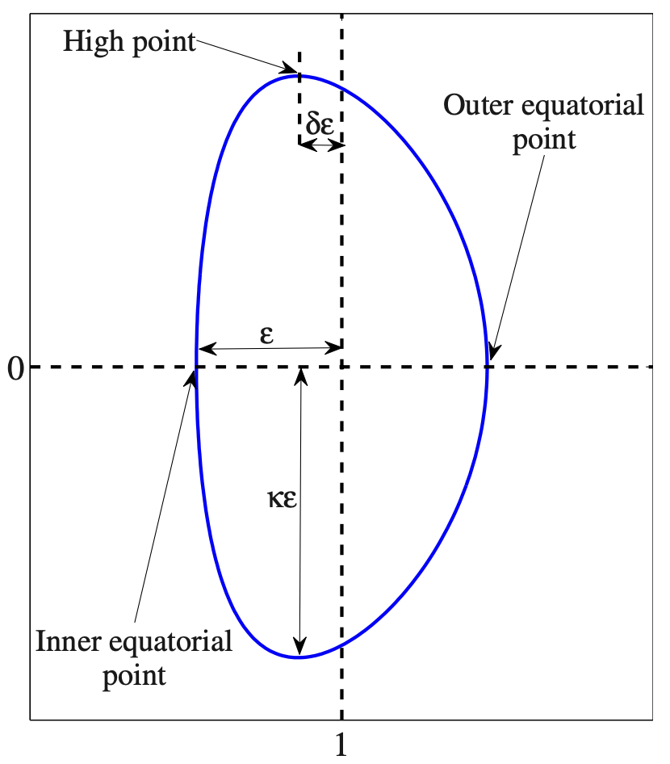
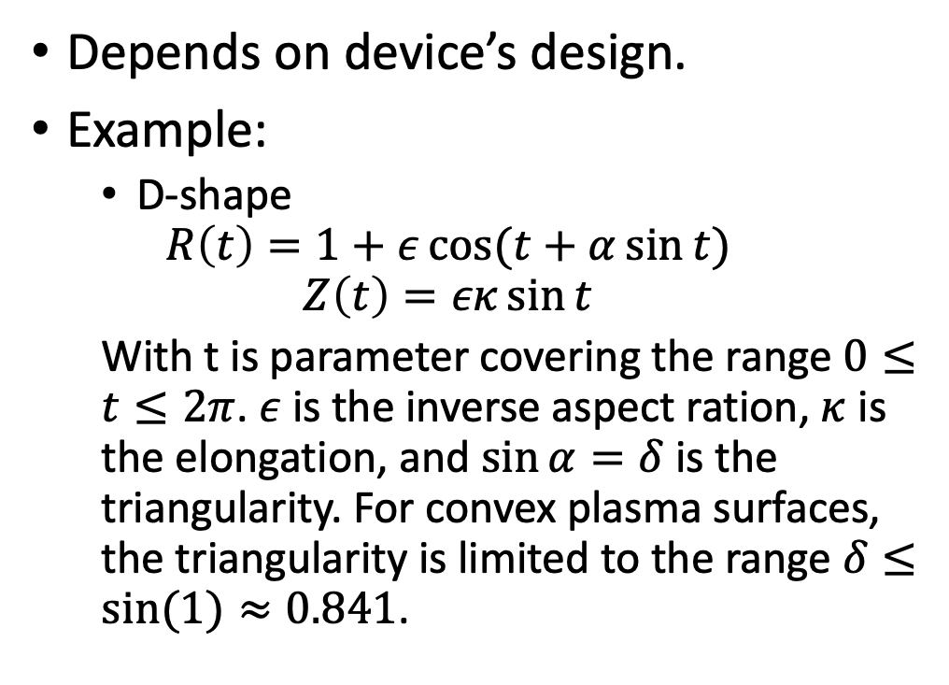
Boundary condition
Depends on device’s design.
Example:
D-shape
$$R\left(t\right)=1+ε\cos{(t+α\sin{t})}$$
$$Z\left(t\right)=εκ\sin{t}$$
With t is parameter covering the range $0≤t≤2π$. $ε$ is the inverse aspect ration, $κ$ is the elongation, and $\sin{α}=δ$ is the triangularity. For convex plasma surfaces, the triangularity is limited to the range $δ≤sin⁡(1)≈0.841$.

Slide 4
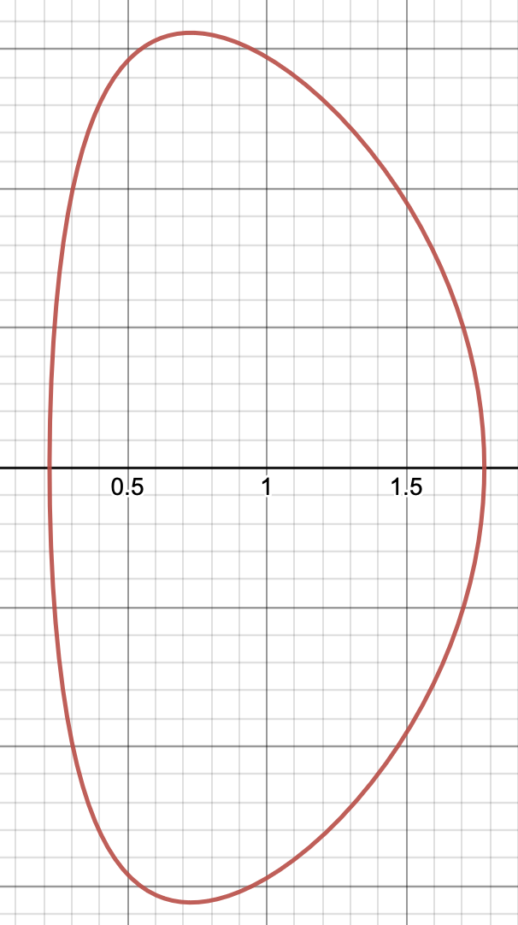

Boundary condition
Example for $ε=0.78, α=0.3576, κ=2$

Slide 5
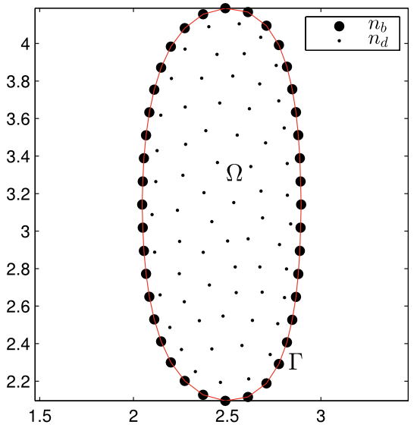
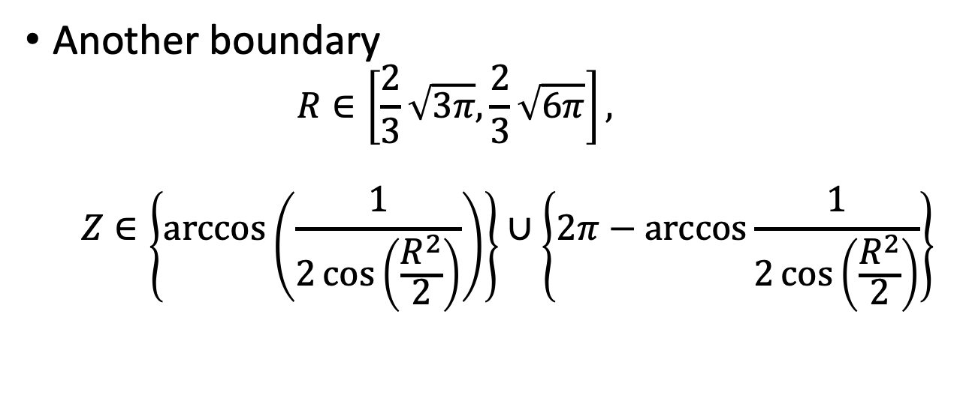
Another boundary
$$R∈\left[\frac{2}{3}\sqrt{3π},\frac{2}{3}\sqrt{6π}\right],$$
$$Z∈\left\{\arccos\left(\frac{1}{2\cos\left(\frac{R^{2}}{2}\right)}\right)\right\}∪\left\{2π−\arccos{\frac{1}{2\cos\left(\frac{R^{2}}{2}\right)}}\right\}$$

Slide 6
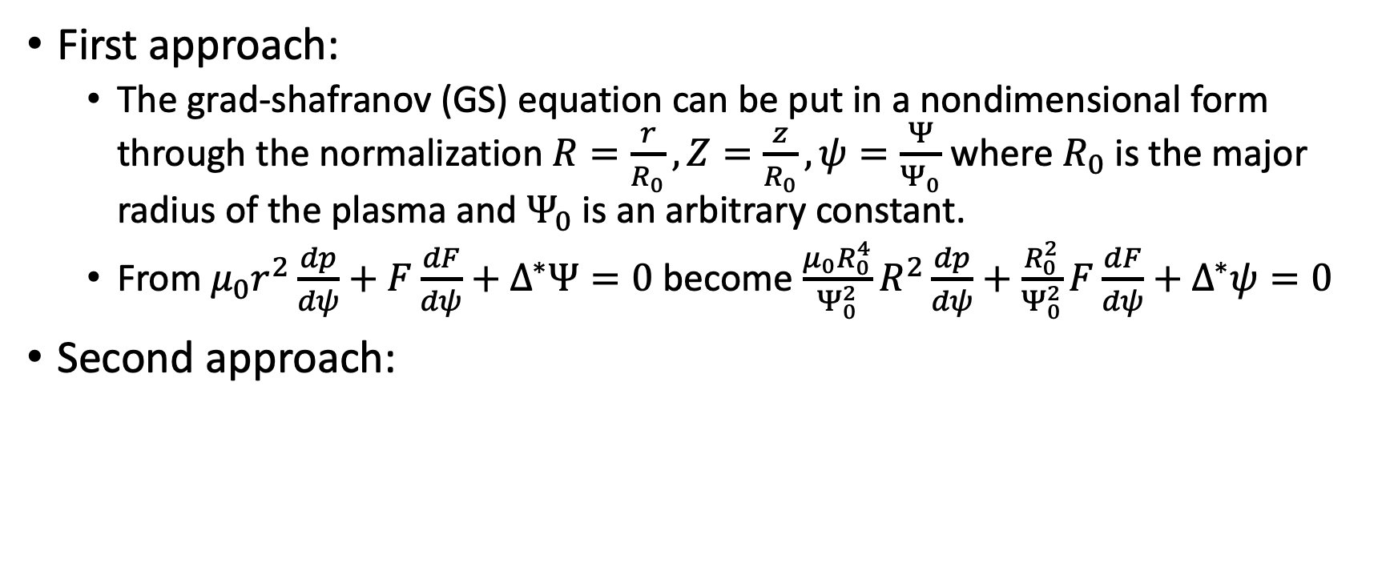
Nondimensionalizing
First approach:
The grad-shafranov (GS) equation can be put in a nondimensional form through the normalization $R=\frac{r}{R_{0}},Z=\frac{z}{R_{0}},ψ=\frac{Ψ}{Ψ_{0}}$ where $R_{0}$ is the major radius of the plasma and $Ψ_{0}$ is an arbitrary constant.
From $μ_{0}r^{2}\frac{dp}{dψ}+F\frac{dF}{dψ}+Δ^{∗}Ψ=0$ become $\frac{μ_{0}R_{0}^{4}}{Ψ_{0}^{2}}R^{2}\frac{dp}{dψ}+\frac{R_{0}^{2}}{Ψ_{0}^{2}}F\frac{dF}{dψ}+Δ^{∗}ψ=0$
Second approach:

Slide 7
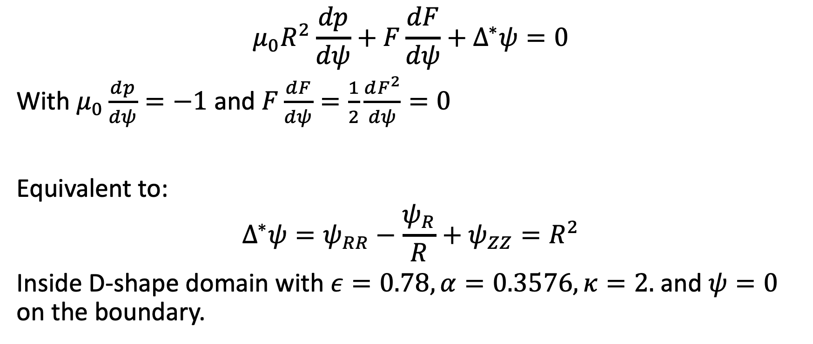
Solov’ev Equilibrium
$$μ_{0}R^{2}\frac{dp}{dψ}+F\frac{dF}{dψ}+Δ^{∗}ψ=0$$
With $μ_{0}\frac{dp}{dψ}=−1$ and $F\frac{dF}{dψ}=\frac{1}{2}\frac{dF^{2}}{dψ}=0$
Equivalent to:
$$Δ^{∗}ψ=ψ_{RR}−\frac{ψ_{R}}{R}+ψ_{ZZ}=R^{2}$$
Inside D-shape domain with $ε=0.78, α=0.3576, κ=2.$ and $ψ=0$ on the boundary.

Slide 8
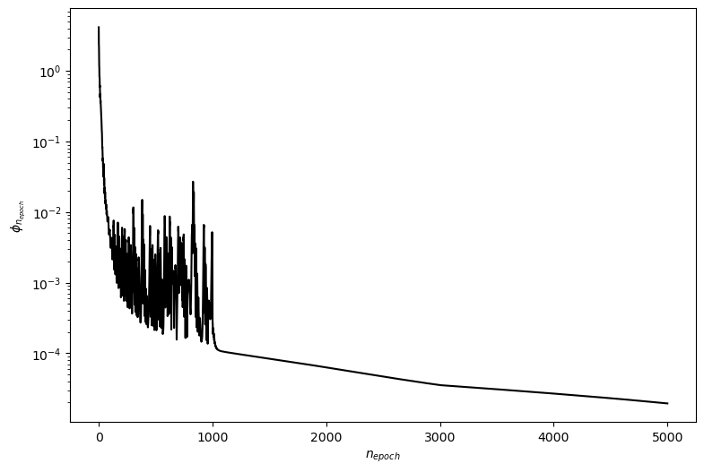
Solov’ev equilibrium
Using PINN with 8 layers, 20 neuron/layer and tanh activation function, after 5000 iteration the error is:

Slide 9
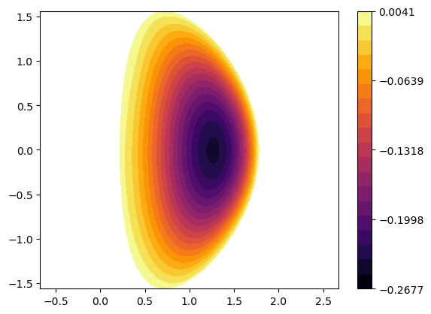
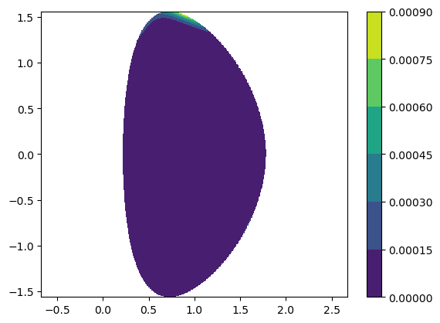
Solov’ev equilibrium
Approximate solution:
Differential residual:

Slide 10
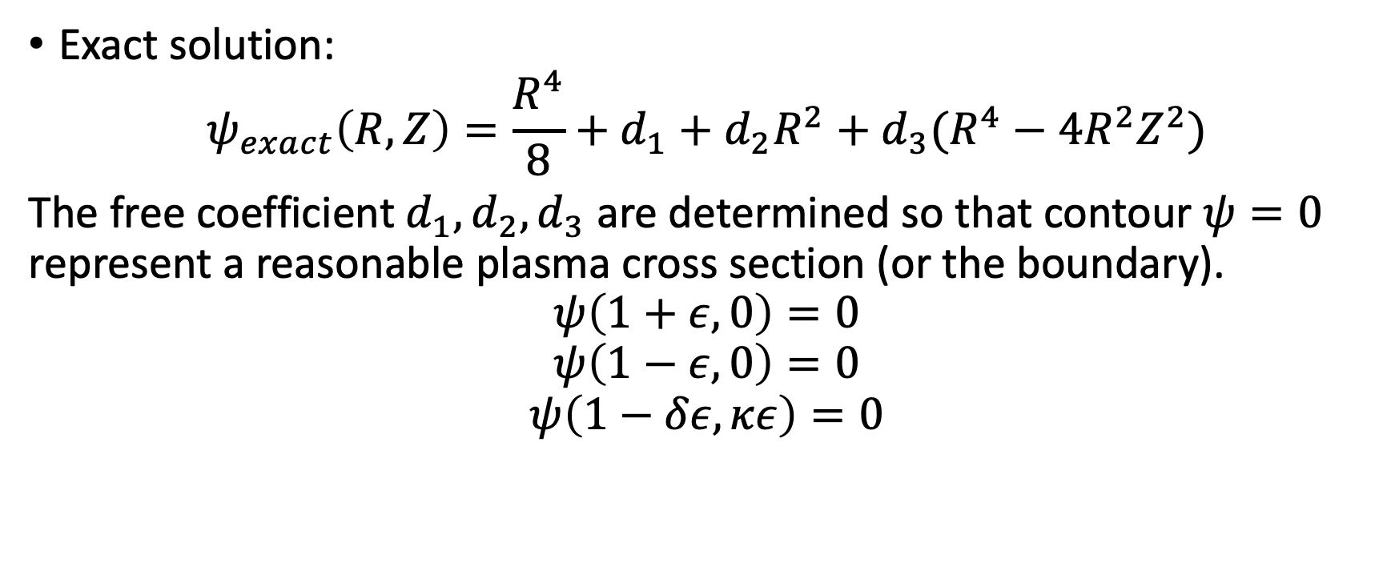
Analytic solution of solov’ev equilibrium
Exact solution:
$$ψ_{exact}\left(R,Z\right)=\frac{R^{4}}{8}+d_{1}+d_{2}R^{2}+d_{3}(R^{4}−4R^{2}Z^{2})$$
The free coefficient $d_{1},d_{2},d_{3}$ are determined so that contour $ψ=0$ represent a reasonable plasma cross section (or the boundary).
$$ψ\left(1+ε,0\right)=0$$
$$ψ\left(1−ε,0\right)=0$$
$$ψ\left(1−δε,κε\right)=0$$

Slide 11
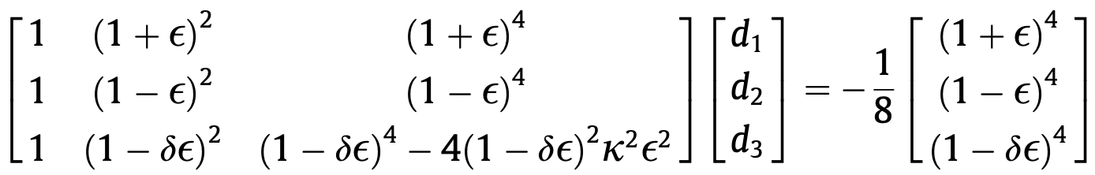
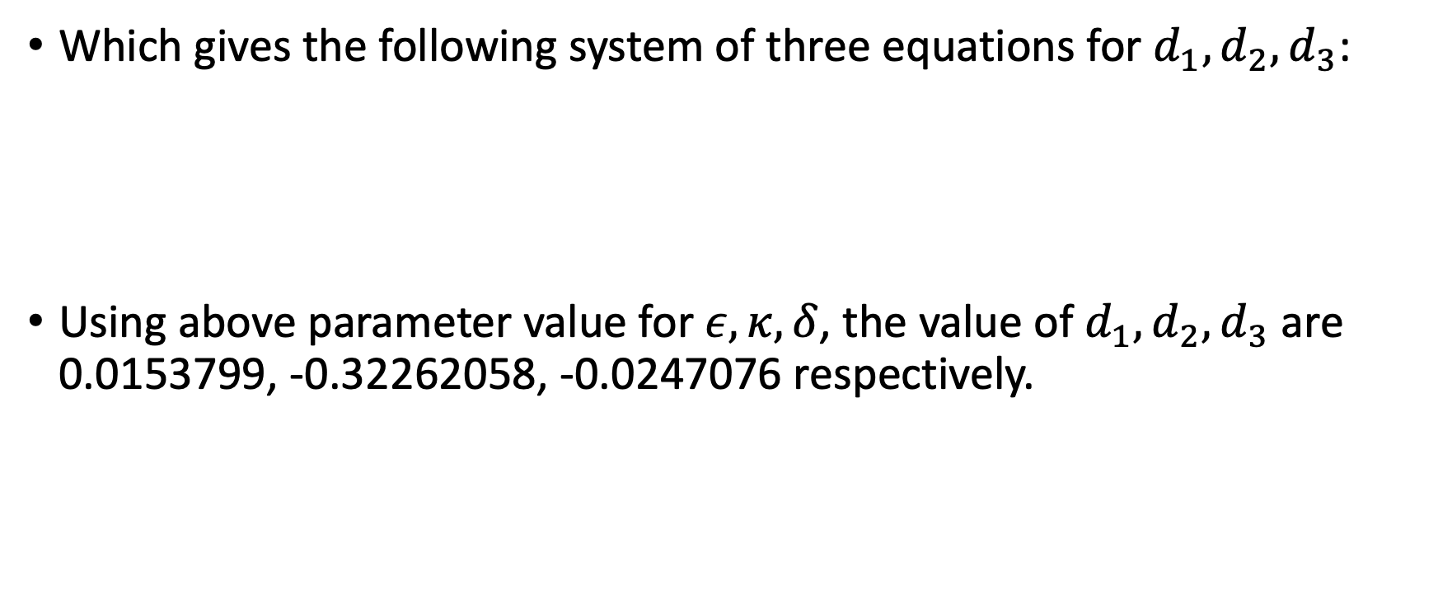
Analytic solution of solovev equilibrium
Which gives the following system of three equations for $d_{1},d_{2},d_{3}$:
Using above parameter value for $ε,κ,δ$, the value of $d_{1},d_{2},d_{3}$ are 0.0153799, -0.32262058, -0.0247076 respectively.

Slide 12
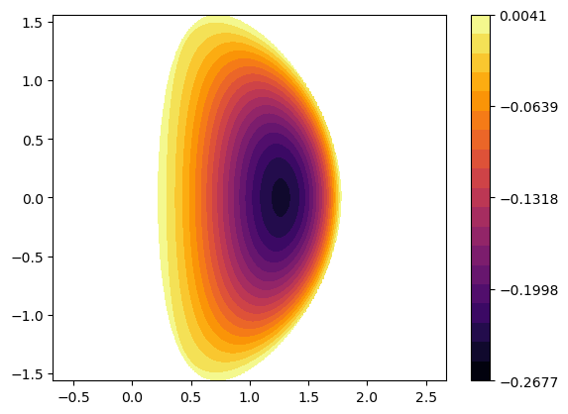
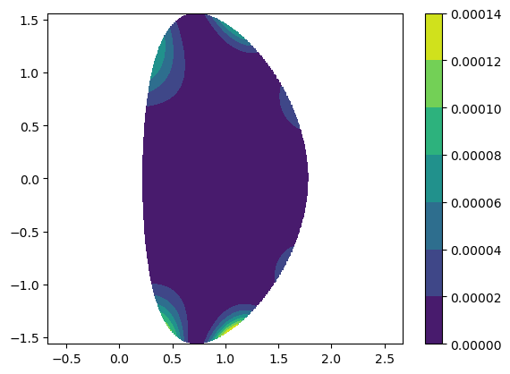
analytic solution of solovev equilibrium
Analytic solution:
Absolute difference between approximate and analytic solution

